Slide 1
Lab Seminar
2024.04.29
16:00(UTC+9)
Seungwan Woo (UST)
Notes:
Today is my first lab seminar, and to briefly introduce myself, I'm Seungwan Woo, the first semester of the integrated course.

Slide 2
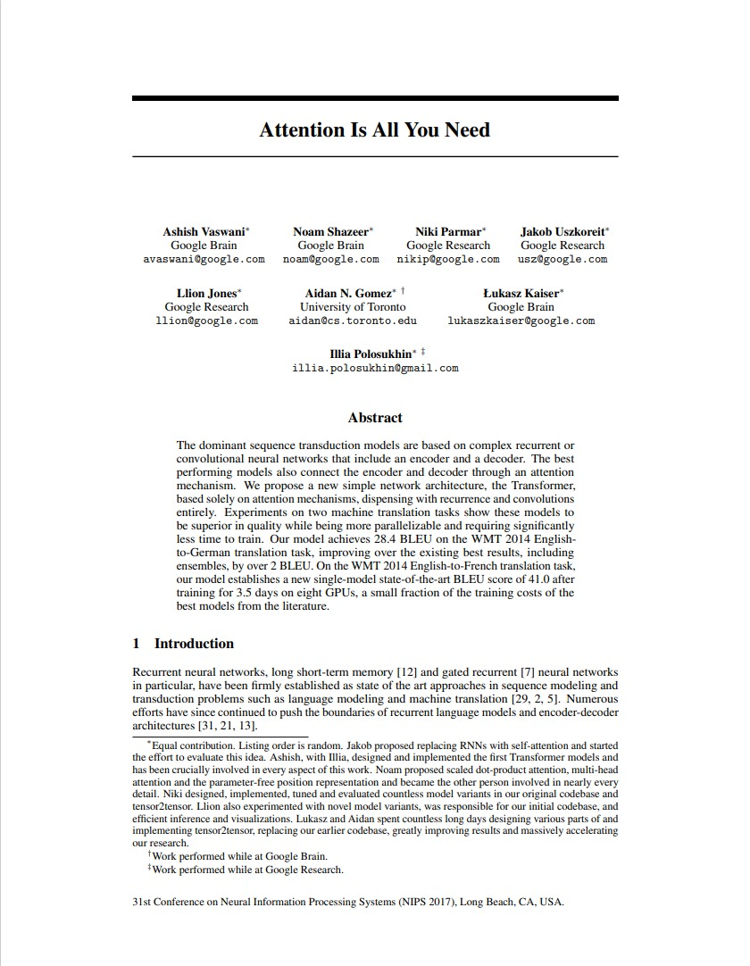
Introduction
Attention Is All You Need
NeurIPS 2017
Google Brain
Citation: 117,858
Notes:
What I prepared today is a review of the paper 'Attention is all you need'.

Slide 3
Sutskever, Ilya, Oriol Vinyals, and Quoc V. Le. "Sequence to sequence learning with neural networks." Advances in neural information processing systems 27 (2014).
Background
Seq2Seq
ravi
de
vous
recontrer
<end>
Context
LSTM
LSTM
LSTM
LSTM
LSTM
LSTM
LSTM
LSTM
LSTM
nice
to
meet
you
<start>
ravi
de
vous
recontrer
Encoder
Decoder
Notes:
Before I start the paper review, I think I need to have knowledge of the seq2seq model, so I'm going to explain it. This is an example of a French translation of nice to meet you with a machine translation seq2seq model.

Slide 4
Sutskever, Ilya, Oriol Vinyals, and Quoc V. Le. "Sequence to sequence learning with neural networks." Advances in neural information processing systems 27 (2014).
Background
Seq2Seq
Context
LSTM
LSTM
LSTM
LSTM
nice
to
meet
you
Encoder
Decoder
Notes:
Seq2Seq generates a context vector by compressing the information in the input sequence.

Slide 5
Sutskever, Ilya, Oriol Vinyals, and Quoc V. Le. "Sequence to sequence learning with neural networks." Advances in neural information processing systems 27 (2014).
Background
Seq2Seq
ravi
Context
LSTM
LSTM
LSTM
LSTM
LSTM
nice
to
meet
you
<start>
Encoder
Decoder
Notes:
Based on the context vector, generate the French equivalent of nice as an output

Slide 6
Sutskever, Ilya, Oriol Vinyals, and Quoc V. Le. "Sequence to sequence learning with neural networks." Advances in neural information processing systems 27 (2014).
Background
Seq2Seq
ravi
de
Context
LSTM
LSTM
LSTM
LSTM
LSTM
LSTM
nice
to
meet
you
<start>
ravi
Encoder
Decoder
Notes:
Next, generate output corresponding to 'to'.

Slide 7
Sutskever, Ilya, Oriol Vinyals, and Quoc V. Le. "Sequence to sequence learning with neural networks." Advances in neural information processing systems 27 (2014).
Background
Seq2Seq
ravi
de
vous
recontrer
<end>
Context
LSTM
LSTM
LSTM
LSTM
LSTM
LSTM
LSTM
LSTM
LSTM
nice
to
meet
you
<start>
ravi
de
vous
recontrer
Encoder
Decoder
Notes:
In this way, seq2seq repeats until the end signal comes out, and when the end signal comes out, the translation is over.

Slide 8
Sutskever, Ilya, Oriol Vinyals, and Quoc V. Le. "Sequence to sequence learning with neural networks." Advances in neural information processing systems 27 (2014).
Background
Seq2Seq
ravi
de
vous
recontrer
<end>
Context
LSTM
LSTM
LSTM
LSTM
LSTM
LSTM
LSTM
LSTM
LSTM
nice
to
meet
you
<start>
ravi
de
vous
recontrer
Encoder
Decoder
Weaknesses
Lower performance because of using a fixed-size context vector
Slower processing speed because of problems with parallel processing
Notes:
Seq2seq has a simple model structure, but it has disadvantages of low speed due to poor performance and impossible parallel processing when sentences are prolonged due to the use of fixed context vectors.

Slide 9
Bahdanau, Dzmitry, Kyunghyun Cho and Yoshua Bengio. “Neural Machine Translation by Jointly Learning to Align and Translate.” CoRR abs/1409.0473 (2014): n. pag.
Background
Seq2Seq with attention
<end>
softmax
ravi
de
vous
recontrer
LSTM
LSTM
LSTM
LSTM
LSTM
LSTM
LSTM
LSTM
LSTM
nice
to
meet
you
<start>
ravi
de
vous
recontrer
Notes:
This is seq2seq with attention, adding attention to compensate for the problems of the seq2seq model. The basic idea is that the encoder references the entire input sentence.

Slide 10
Bahdanau, Dzmitry, Kyunghyun Cho and Yoshua Bengio. “Neural Machine Translation by Jointly Learning to Align and Translate.” CoRR abs/1409.0473 (2014): n. pag.
Background
Seq2Seq with attention
ravi
softmax
LSTM
LSTM
LSTM
LSTM
LSTM
nice
to
meet
you
<start>
Notes:
Decoder receives a start token as an input. And it performs an internal operation with a vector corresponding to each nice, to, meet, and you, converts these values into probability values using the softmax function, and then outputs the word with the highest probability.

Slide 11
Bahdanau, Dzmitry, Kyunghyun Cho and Yoshua Bengio. “Neural Machine Translation by Jointly Learning to Align and Translate.” CoRR abs/1409.0473 (2014): n. pag.
Background
Seq2Seq with attention
de
softmax
ravi
LSTM
LSTM
LSTM
LSTM
LSTM
LSTM
nice
to
meet
you
<start>
ravi
Notes:
Then, the output value ravi (하비) is received as input and the same process is performed.

Slide 12
Bahdanau, Dzmitry, Kyunghyun Cho and Yoshua Bengio. “Neural Machine Translation by Jointly Learning to Align and Translate.” CoRR abs/1409.0473 (2014): n. pag.
Background
Seq2Seq with attention
<start>
softmax
ravi
de
vous
recontrer
LSTM
LSTM
LSTM
LSTM
LSTM
LSTM
LSTM
LSTM
LSTM
nice
to
meet
you
<start>
ravi
de
vous
recontrer
Notes:
The process is also carried out until the end signal comes out.

Slide 13
Bahdanau, Dzmitry, Kyunghyun Cho and Yoshua Bengio. “Neural Machine Translation by Jointly Learning to Align and Translate.” CoRR abs/1409.0473 (2014): n. pag.
Background
Seq2Seq with attention
<start>
softmax
ravi
de
vous
recontrer
LSTM
LSTM
LSTM
LSTM
LSTM
LSTM
LSTM
LSTM
LSTM
nice
to
meet
you
<start>
ravi
de
vous
recontrer
Weaknesses
Slower processing speed because of problems with parallel processing
Notes:
Seq2seq with attention has solved the problems that can occur when a sentence is long, but because it is RNN-based, it is not parallelized, so there is still a disadvantage of slow speed.

Slide 14
So, the authors propose that Transformer use only the attention mechanism to solve this problem.
Notes:
So, the authors propose that Transformer use only the attention mechanism to solve this problem.

Slide 15
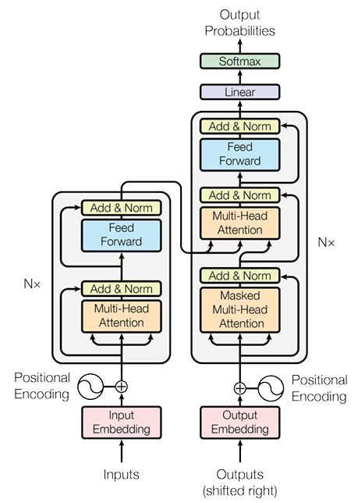
Vaswani, A., Shazeer, N., Parmar, N., Uszkoreit, J., Jones, L., Gomez, A. N., ... & Polosukhin, I. (2017). Attention is all you need. Advances in neural information processing systems, 30.
Method
Decoder
Encoder
Notes:
Transformer consists of Encoder and Decoder, as described models.

Slide 16
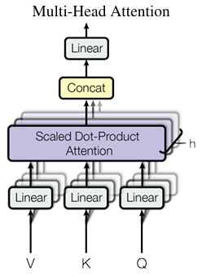
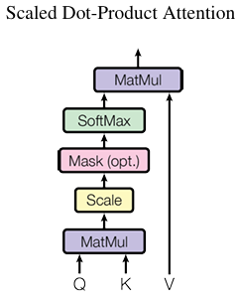
Vaswani, A., Shazeer, N., Parmar, N., Uszkoreit, J., Jones, L., Gomez, A. N., ... & Polosukhin, I. (2017). Attention is all you need. Advances in neural information processing systems, 30.
Method
Notes:
'Transformer' features multi-head attention and scaled dot product attention, also called self-attention.

Slide 17
Vaswani, A., Shazeer, N., Parmar, N., Uszkoreit, J., Jones, L., Gomez, A. N., ... & Polosukhin, I. (2017). Attention is all you need. Advances in neural information processing systems, 30.
Method
What is Self-Attention(Scaled Dot-Product Attention)?
Attention:
Who is the singer?
They love a song by Kodaline, a singer from their hometown, Ireland.
Self-Attention:
I saw her tear the paper and shed a tear for her last love
Notes:
Let me first explain about self-attention. In the case of attention, it plays a role in helping the model focus on the more important part of the input value. In the case of self-attention, attention is calculated based on the relationship between tokens in the same sentence. Attention for who is the song will be they, Kodaline, and singer, and self-attention will look at the relationship between paper and tear and interpret 'tear', which means rip, and 'blue tear' will mean 'tear drop' in relation to 'shed'.

Slide 18












Vaswani, A., Shazeer, N., Parmar, N., Uszkoreit, J., Jones, L., Gomez, A. N., ... & Polosukhin, I. (2017). Attention is all you need. Advances in neural information processing systems, 30.
Method
So, What is Query, Key, Value?
MatMul
SoftMax
Scale
Query: The information vector that seeks relevant parts within the input sequence (Source).
Key: The vector used for comparing with the query to determine the degree of association in the relationship (Target).
Value: The vector used to compute weights with information from the input sequence corresponding to a specific key (Value).
MatMul
Linear
Linear
Linear
$$e_{p}^{0}$$
$$e_{p}^{1}$$
$$e_{p}^{2}$$
$$e_{p}^{3}$$
$$e_{p}^{4}$$
$$e_{p}^{5}$$
$$e_{p}^{0}$$
$$e_{p}^{1}$$
$$e_{p}^{2}$$
$$e_{p}^{3}$$
$$e_{p}^{4}$$
$$e_{p}^{5}$$
$$e_{p}^{0}$$
$$e_{p}^{1}$$
$$e_{p}^{2}$$
$$e_{p}^{3}$$
$$e_{p}^{4}$$
$$e_{p}^{5}$$
The
shetland
sheepdog
is
so
affectionate
The
shetland
sheepdog
is
so
affectionate
The
shetland
sheepdog
is
so
affectionate
Q
K
V
Notes:
Query is the information vector that seeks relevant parts within the input sequence.Key is The vector used for comparing with the query to determine the degree of association in the relationship.Value is the vector used to compute weights with information from the input sequence corresponding to a specific key. Simply, Query is Source, Key is Target, Value is Value

Slide 19










Vaswani, A., Shazeer, N., Parmar, N., Uszkoreit, J., Jones, L., Gomez, A. N., ... & Polosukhin, I. (2017). Attention is all you need. Advances in neural information processing systems, 30.
Method
6 X 4
4 X 3
6 X 3
Linear Layer
MatMul
X
=
The
shetland
sheepdog
is
so
affectionate
SoftMax
6 X 4
4 X 3
6 X 3
Scale
MatMul
X
=
Linear
Linear
Linear
$$e_{p}^{0}$$
$$e_{p}^{1}$$
$$e_{p}^{2}$$
$$e_{p}^{3}$$
$$e_{p}^{4}$$
$$e_{p}^{5}$$
$$e_{p}^{0}$$
$$e_{p}^{1}$$
$$e_{p}^{2}$$
$$e_{p}^{3}$$
$$e_{p}^{4}$$
$$e_{p}^{5}$$
$$e_{p}^{0}$$
$$e_{p}^{1}$$
$$e_{p}^{2}$$
$$e_{p}^{3}$$
$$e_{p}^{4}$$
$$e_{p}^{5}$$
6 X 4
4 X 3
6 X 3
The
shetland
sheepdog
is
so
affectionate
The
shetland
sheepdog
is
so
affectionate
The
shetland
sheepdog
is
so
affectionate
X
=
Q
K
V
Notes:
For Query, Key, and Value, the same Embedding and Position are entered, respectively. To create a structure suitable for parallel computation by reducing the dimensions of Query, Key, and Value, a linear operation is performed.

Slide 20
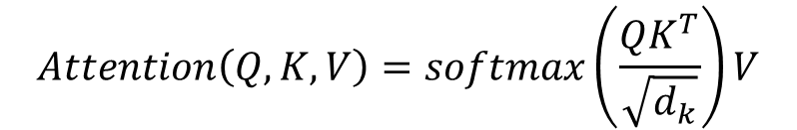



Vaswani, A., Shazeer, N., Parmar, N., Uszkoreit, J., Jones, L., Gomez, A. N., ... & Polosukhin, I. (2017). Attention is all you need. Advances in neural information processing systems, 30.
Method
Attention Score
MatMul
SoftMax
6 X 3
3 X 6
6 X 6
Scale
X
=
MatMul
Linear
Linear
Linear
Query
Key
Attention Score
$$e_{p}^{0}$$
$$e_{p}^{1}$$
$$e_{p}^{2}$$
$$e_{p}^{3}$$
$$e_{p}^{4}$$
$$e_{p}^{5}$$
$$e_{p}^{0}$$
$$e_{p}^{1}$$
$$e_{p}^{2}$$
$$e_{p}^{3}$$
$$e_{p}^{4}$$
$$e_{p}^{5}$$
$$e_{p}^{0}$$
$$e_{p}^{1}$$
$$e_{p}^{2}$$
$$e_{p}^{3}$$
$$e_{p}^{4}$$
$$e_{p}^{5}$$
$$Attention\left(Q,K,V\right)=softmax\left(\frac{QK^{T}}{\sqrt{d_{k}}}\right)V$$
The
shetland
sheepdog
is
so
affectionate
The
shetland
sheepdog
is
so
affectionate
The
shetland
sheepdog
is
so
affectionate
Q
K
V
Notes:
The same Q, K, and V values are obtained through the Linear operation, and the Attention Score is obtained by dot product Q and K first. The Attention Score represents a similarity matrix between Q and K.

Slide 21
Vaswani, A., Shazeer, N., Parmar, N., Uszkoreit, J., Jones, L., Gomez, A. N., ... & Polosukhin, I. (2017). Attention is all you need. Advances in neural information processing systems, 30.
Method
Attention Score
Attention Score
6 X 6
78
20
61
15
The
89
36
91
25
shetland
96
27
93
87
55
18
88
46
sheepdog
38
48
31
37
71
23
is
35
91
20
88
47
87
so
67
97
18
77
affectionate
39
89
The
52
70
shetland
sheepdog
is
so
affectionate
Notes:
If you look at the Attention Score, you can see that the value mapped to itself is the largest and the next similar value is the largest.

Slide 22
Vaswani, A., Shazeer, N., Parmar, N., Uszkoreit, J., Jones, L., Gomez, A. N., ... & Polosukhin, I. (2017). Attention is all you need. Advances in neural information processing systems, 30.
Method
Scaling & Softmax
Attention Score
MatMul
6 X 6
SoftMax
78
20
61
15
The
89
36
Scale
91
25
shetland
96
27
93
87
55
18
88
46
sheepdog
38
48
MatMul
31
37
71
23
is
35
91
20
88
Linear
Linear
Linear
47
87
so
67
97
18
77
$$e_{p}^{0}$$
$$e_{p}^{1}$$
$$e_{p}^{2}$$
$$e_{p}^{3}$$
$$e_{p}^{4}$$
$$e_{p}^{5}$$
$$e_{p}^{0}$$
$$e_{p}^{1}$$
$$e_{p}^{2}$$
$$e_{p}^{3}$$
$$e_{p}^{4}$$
$$e_{p}^{5}$$
$$e_{p}^{0}$$
$$e_{p}^{1}$$
$$e_{p}^{2}$$
$$e_{p}^{3}$$
$$e_{p}^{4}$$
$$e_{p}^{5}$$
affectionate
39
89
The
52
70
shetland
sheepdog
is
so
affectionate
The
shetland
sheepdog
is
so
affectionate
The
shetland
sheepdog
is
so
affectionate
The
shetland
sheepdog
is
so
affectionate
Q
K
V
Notes:
When softmax is performed using a large value, only a specific value survives excessively and the remaining values disappear, so scaling is performed. And generalization is performed.

Slide 23
Vaswani, A., Shazeer, N., Parmar, N., Uszkoreit, J., Jones, L., Gomez, A. N., ... & Polosukhin, I. (2017). Attention is all you need. Advances in neural information processing systems, 30.
Method
MatMul
SoftMax
Scale
MatMul
X
=
Linear
Linear
Linear
$$e_{p}^{0}$$
$$e_{p}^{1}$$
$$e_{p}^{2}$$
$$e_{p}^{3}$$
$$e_{p}^{4}$$
$$e_{p}^{5}$$
Attention Score
Value
Self-Attention Value
$$e_{p}^{0}$$
$$e_{p}^{1}$$
$$e_{p}^{2}$$
$$e_{p}^{3}$$
$$e_{p}^{4}$$
$$e_{p}^{5}$$
$$e_{p}^{0}$$
$$e_{p}^{1}$$
$$e_{p}^{2}$$
$$e_{p}^{3}$$
$$e_{p}^{4}$$
$$e_{p}^{5}$$
The
shetland
sheepdog
is
so
affectionate
The
shetland
sheepdog
is
so
affectionate
The
shetland
sheepdog
is
so
affectionate
Q
K
V
Notes:
Finally, by internalizing the value and normalized Attention Score, the self-attention process is completed.

Slide 24
Vaswani, A., Shazeer, N., Parmar, N., Uszkoreit, J., Jones, L., Gomez, A. N., ... & Polosukhin, I. (2017). Attention is all you need. Advances in neural information processing systems, 30.
Method
Multi-Head Attention
Which do you like better, coffee or tea?
Attention on sentence type
Which do you like better, coffee or tea?
Attention on noun
Which do you like better, coffee or tea?
Attention on relationship
Which do you like better, coffee or tea?
Attention on emphasis
Notes:
Transformer is a multi-head attention structure that learns self-attention h times in parallel. Why use multi-head attention? This is because it is possible to apply attention to multiple parts at the same time, so that various types of input tokens can be identified and information from various sources can be combined. I will explain the sentence "Which do you like better, coffee or tea?" as an example. One head is a sentence type, another head is a noun, another head is a relationship, and another head focuses attention on emphasis, which has the advantage of being able to deal with more complex relationships between input tokens and improving expressive power.

Slide 25
Vaswani, A., Shazeer, N., Parmar, N., Uszkoreit, J., Jones, L., Gomez, A. N., ... & Polosukhin, I. (2017). Attention is all you need. Advances in neural information processing systems, 30.
Method
Positional encoding
Positional Encoding
+
+
+
+
+
Input Embedding
nice
to
meet
you
nice
to
meet
you
Notes:
Transformers do not use RNNs, so they have to provide location information for each word in a sentence. Therefore, they encode the location embedding of the word.

Slide 26
Vaswani, A., Shazeer, N., Parmar, N., Uszkoreit, J., Jones, L., Gomez, A. N., ... & Polosukhin, I. (2017). Attention is all you need. Advances in neural information processing systems, 30.
Method
ravi
de
vous
recontrer
<end>
Encoders
Decoders
Positional Encoding
Positional Encoding
Input Embedding
Input Embedding
nice
to
meet
you
<start>
ravi
de
vous
recontrer
Notes:
It's all complicated. If you really put the Transformer model in a really easy way, you can use the Encoder – Decoder model, which is the result of translating nice to meet you into French.

Slide 27
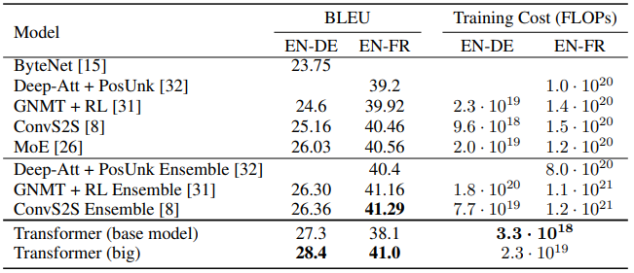
Results
Machine Translation
Notes:
BLEU (블류) is a method of measuring performance by comparing how similar the machine translation result and the human translation result are. The English-to-Geman translation task recorded a low training cost while with high performance compared to other models, and although Sota was not achieved in the English-to-French task, it shows similar performance to Sota with a low training cost.Since then, various follow-up studies have been conducted, including the emergence of the ViT model, which has expanded to the field of computer vision, and transform-based models such as Bert and GPT.

Slide 28
Thank you!
Notes:
This is the end of the lab seminar. Thank you!

